Slide 1
Moderated Regression
Gemma Wallace & Neil Yetz

Slide 2
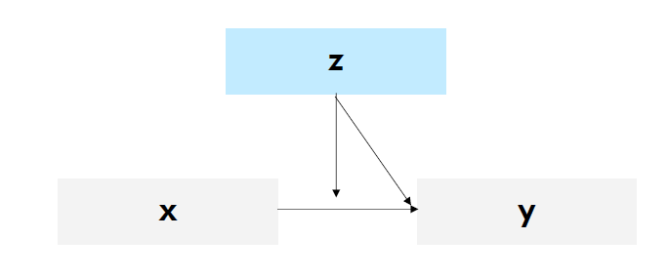
What is Moderation?
A moderator is a variable that changes (i.e., moderates) the relationship between two (or more) other variables
Moderation models are used to determine if the magnitude and/or direction of a certain regression slope varies as a function of some third variable
©Kimberly Henry

Slide 3
What is moderation?
An interaction term = the predicted difference in the effect of x on y for a one-unit increase in z
(i.e., how the simple slope of x on y changes as z increases)
©Kimberly Henry

Slide 4
What does an interaction (aka moderation) effect look like?
No interaction observed:
Interaction observed:
High level of Z
Low level of Z
Y
Y
X
X
Note: crossed lines would also indicate an interaction

Slide 5
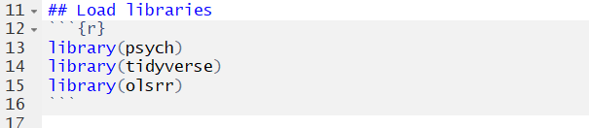
Load libraries

Slide 6
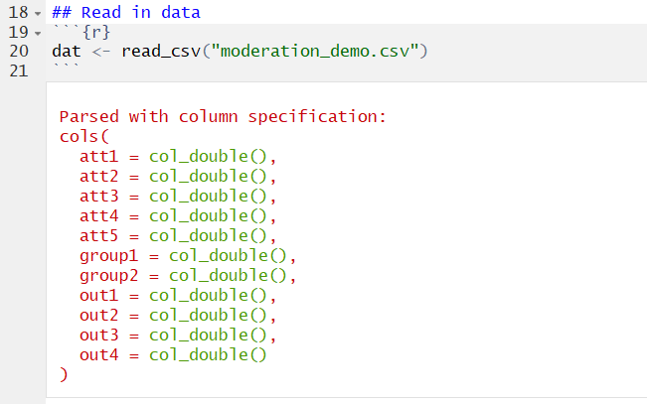
Read in Data

Slide 7
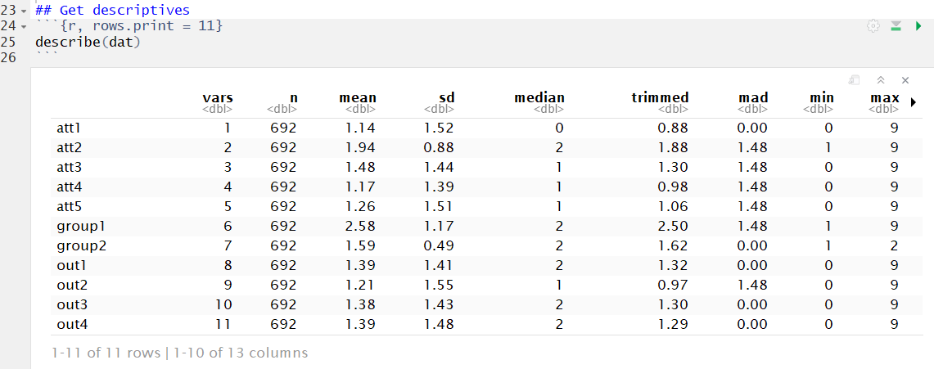
Calculate descriptives
This is a simulated dataset (i.e., the variables don’t have specific meaning)

Slide 8
Our variables of interest
Predictors
Outcome

Slide 9

Examine correlations between the predictors
In general, we want to avoid multicollinearity in multiple linear regression

Slide 10
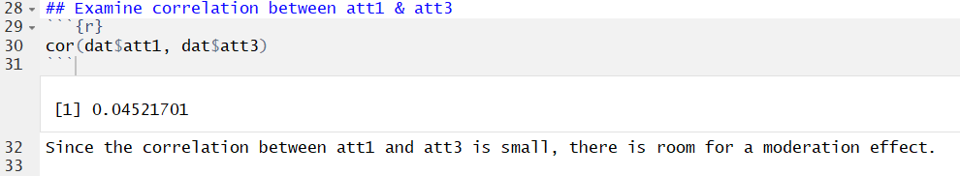
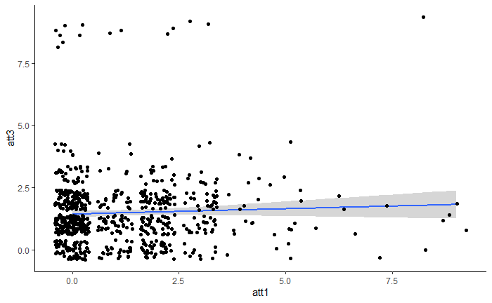
Examine correlations between the predictors

Slide 11
Examine correlations between the predictors

Slide 12

Create the cross-product of the two predictors
The cross-product is the interaction term. We’ll include this as an additional predictor in the regression model.

Slide 13
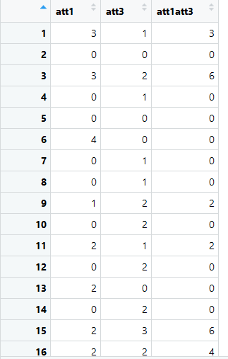
Create the cross product

Slide 14
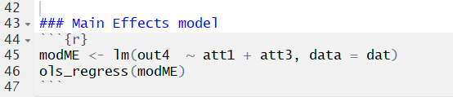
Run the main effects model
This is just a regular multiple linear regression.
We first want to examine the main effects between each predictor and the outcome before adding the interaction term.

Slide 15
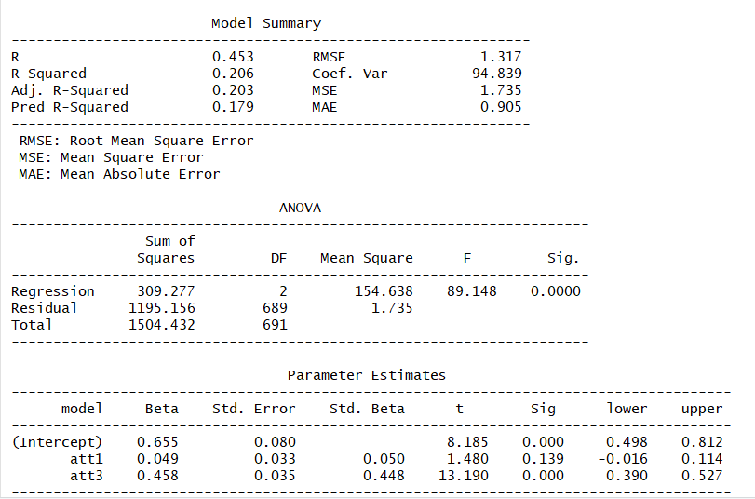
Main effects model results

Slide 16
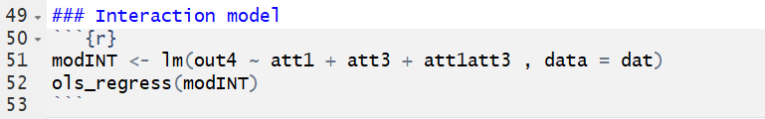
Run the same model with the interaction term
(aka a Moderated Regression)
att1att3 is the cross-product variable we made earlier
It represents att1*att3

Slide 17
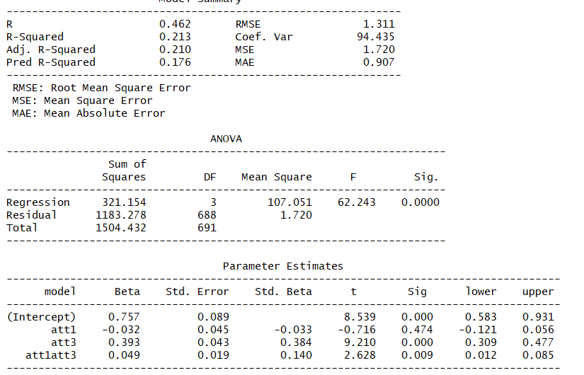
Model
results with interaction term
Simple Slopes
Interaction

Slide 18
Interpreting the moderated regression
att1: This is the predicted change in our outcome for every 1 unit increase in att1 when att3 is 0.
att3: This is the predicted change in our outcome for every 1 unit increase in att3 when att1 is 0.
att1att3: This is the predicted change in the effect of att1 on our outcome for every one unit increase in att3.

Slide 19
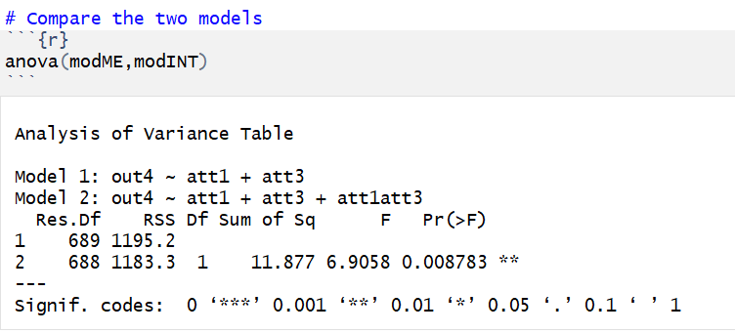
Compare the two models via hierarchical regression
Does including the interaction term significantly improve the amount of variance our model explains in out4?

Slide 20
Compare the two models via hierarchical regression
At p<0.05, the moderated regression model explained significantly more variance in out4 than the main effects model

Slide 21
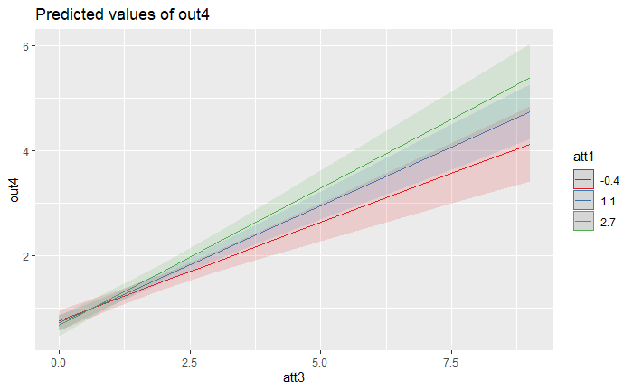
Our interaction - Visualized
1 SD below
Mean
1 SD Above

Slide 22
Our interaction - Visualized
Slopes differ
Lines cross
1 SD below
Mean
1 SD Above

Slide 23
Example APA write up
The differential effect of att1 on out4, using att3 as a moderator, was examined among 692 participants. A moderation model was estimated, out4 was regressed on att1, att3, and the interaction between the two. The simple slope of att1 was not statistically significant (b = -0.03, 95%CI -0.12, 0.06) and the simple slope of att3 (b = 0.39, 95%CI 0.31, 0.48) was statistically significant. The interaction term is statistically significant (b = 0.05, 95%CI 0.01, 0.09), indicating that the effect of att1 on out4 is larger as att3 increases.

Slide 24
Additional considerations for moderation
Power is important!
N needed to detect interaction effect can be up to 9x larger than for detecting main effects (e.g., Wahlsten, 1991)
For every interaction term you add, N needed to detect effect increases
You can examine interactions between more than two variables
E.g., 3-day interactions
Interpretation is easier with categorical predictors
E.g. You can turn continuous variables into categorical by using cut-off scores

